Slide 1

Assistive Robot : Grasping and Motion Generation
Seonghun Cha
Daewon Choi
Seonho Kim
Notes:
Hello
My name is 최대원
Our project name is assistive robot: grasping and motion generation
Let’s start our presentation

Slide 2
Index
Objective
Method
Environments
Demo
Notes:
- I will present in order of goal, method, environment, and demo.
- I'll focus on DEMO.

Slide 3
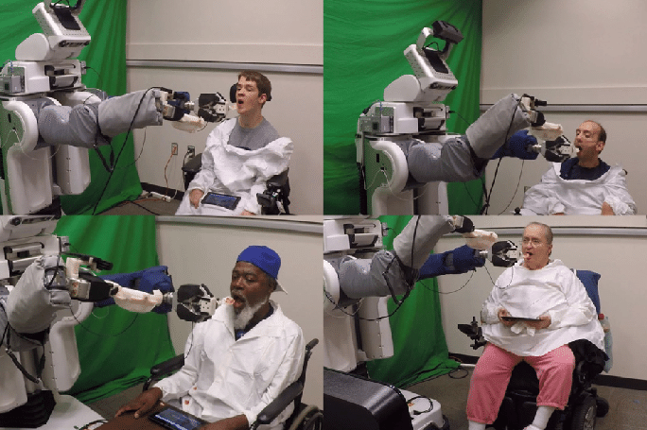
Objective
1) Feeding food to human
2) Massage for human
3) Assistance for human
Notes:
- The objective is to create robot that can help the elderly and patients
- first robot can feed food to human, after picking up the food, it is brought to humans
- second robot can massage instead of humans to patients
- last robot can assistance for human, for example robot can sprinkle ketchup on the food

Slide 4
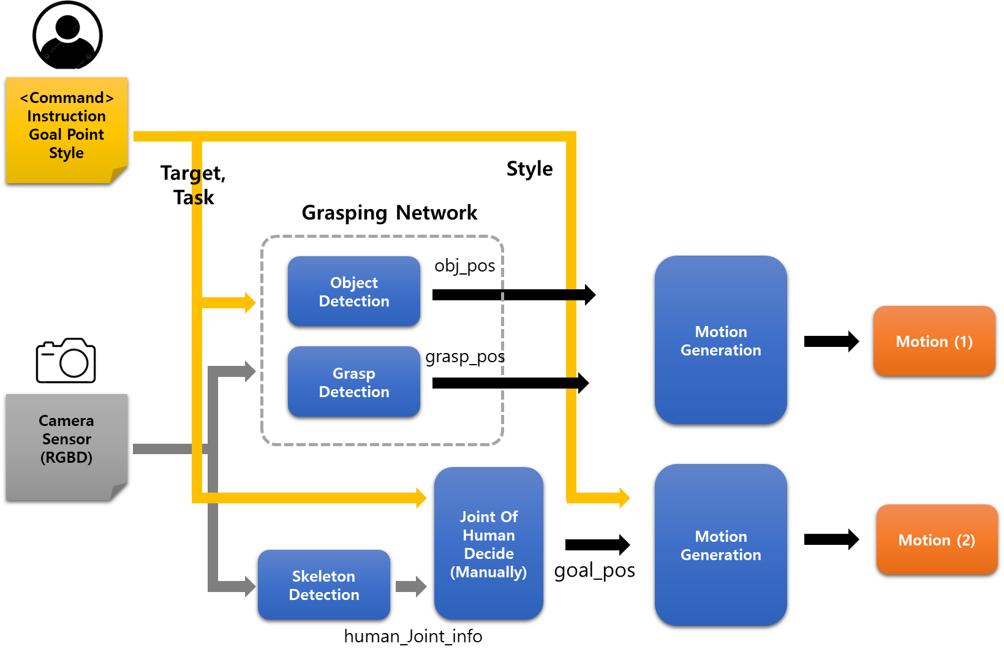
method
Notes:
- This is our overall method
- Let's take a look at it step by step.

Slide 5
method
python main.py --instruction="Feed me something to eat" --goal_point="head" --style="linear"
Notes:
- User enters a command with Instruction, Goal point and style
- RGBD information is obtained from the camera and is also entered into the method
- you can type it as above

Slide 6
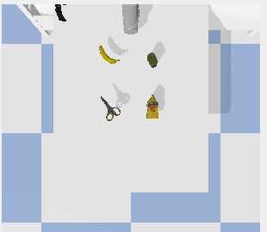
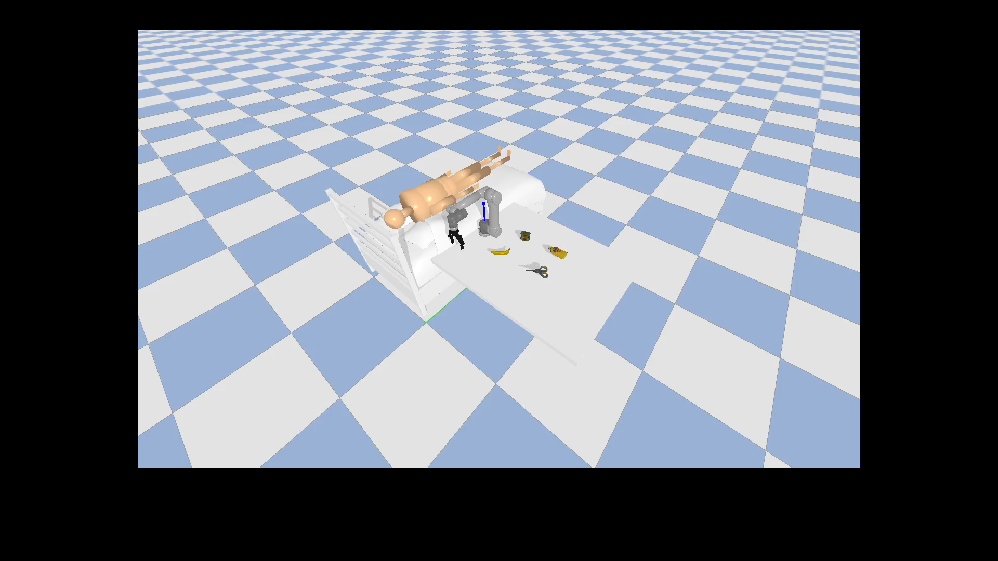
method
Pick Motion
instruction = "I want to eat fruit"
Notes:
- Fist it is Pick Motion Part
- Compare the similarity between the objects and the commands
- and then look for the objects that are most similar.
- Then find the suitable gripping box for the object.
- When robot picked up an object, we used the GRCNN model, a grasping network
- we prepared banana, meat can, Scissors, mustard bottle as example objects
- Since CLIP Network was used, you can select objects by entering various commands.
- The video on the right is the process of grasping by navigating objects from commands.
- we typed “I want to eat fruit”
- Let's show that <비디오 실행>

Slide 7
method
“I would like to eat meat can"
"Give me something to cut"
“Pour the sauce”
Notes:
- Since CLIP Network was used, you can select objects by entering various commands.
- First video we typed “I would like to meat can” <비디오 실행>
- so robot pick up the meat can
- Second video we typed “Give me something to cut” <비디오 실행>
- robot pick up the scissors
- Last video we typed “pour the sauce” <비디오 실행>
- robot pick up the mustard bottle

Slide 8
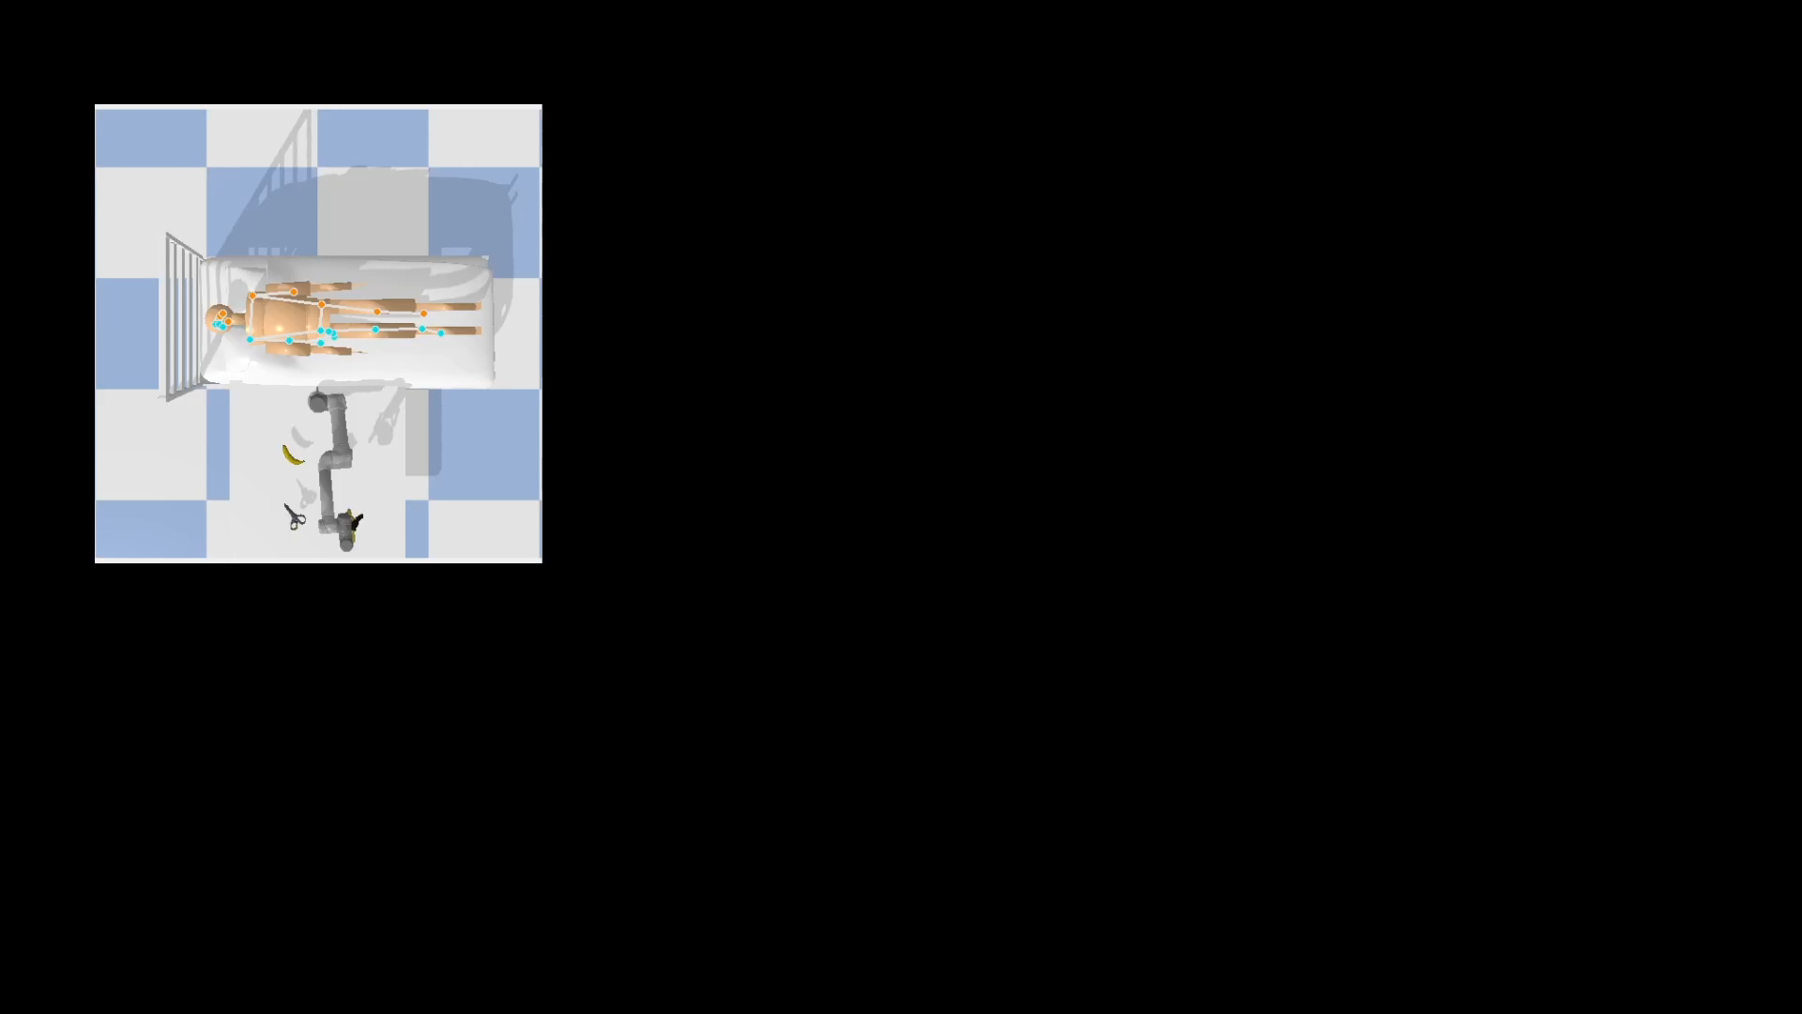
method
Skeleton Detection
Notes:
- After Pick up motion Second part is Skeleton Detection
- Skeleton detection allows you to find multiple joints in a human.
- After combining the position of the joint with the target point entered in the command
- you can find the final target coordinates.
- After that, create motion and move the robot to the goal position.
- The Mediapipe library was used to do Skeleton Detection.
- I'll show you a Skeleton detection video <비디오 실행>
- there are a little errors when detecting humans in the simulation. Because mediapipe learned from real images

Slide 9
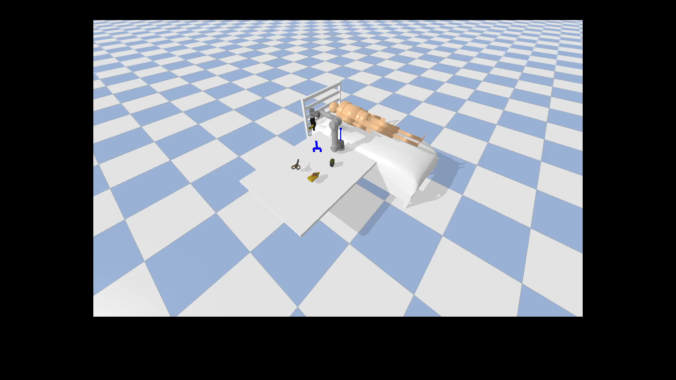
method
Notes:
- this is Motion Generation Part
- In this part, robot bring objects to people.
- The robot can move to the target point based on various motions.
- I'll show you our linear motion <비디오 실행>
- This movement gives things to humans in a straight line.

Slide 10


method
Circular
shaking
Massage
Notes:
- If you look at other motions, it will be easier to understand.
- First circular motion
- It moves in a circle compared to the basic motion. <비디오 실행>
- Second shaking motion
- Shake the bottle and squeeze the mustard well. <비디오 실행>
- third massage motion
- It's a motion that robots can massage for humans. <비디오 실행>
- You can create your own motion, and we provide the code for it.

Slide 11




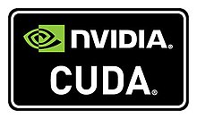

Environments
Driver : 531.14
CUDA : 12.1
(Python 3.11.5)
Docker (Ubuntu 20.04)
Notes:
- It’s the deploy environment
- We installed Anaconda and cuda based on Docker.
- and then we used pybullet, pytorch, mediapipe library

Slide 12
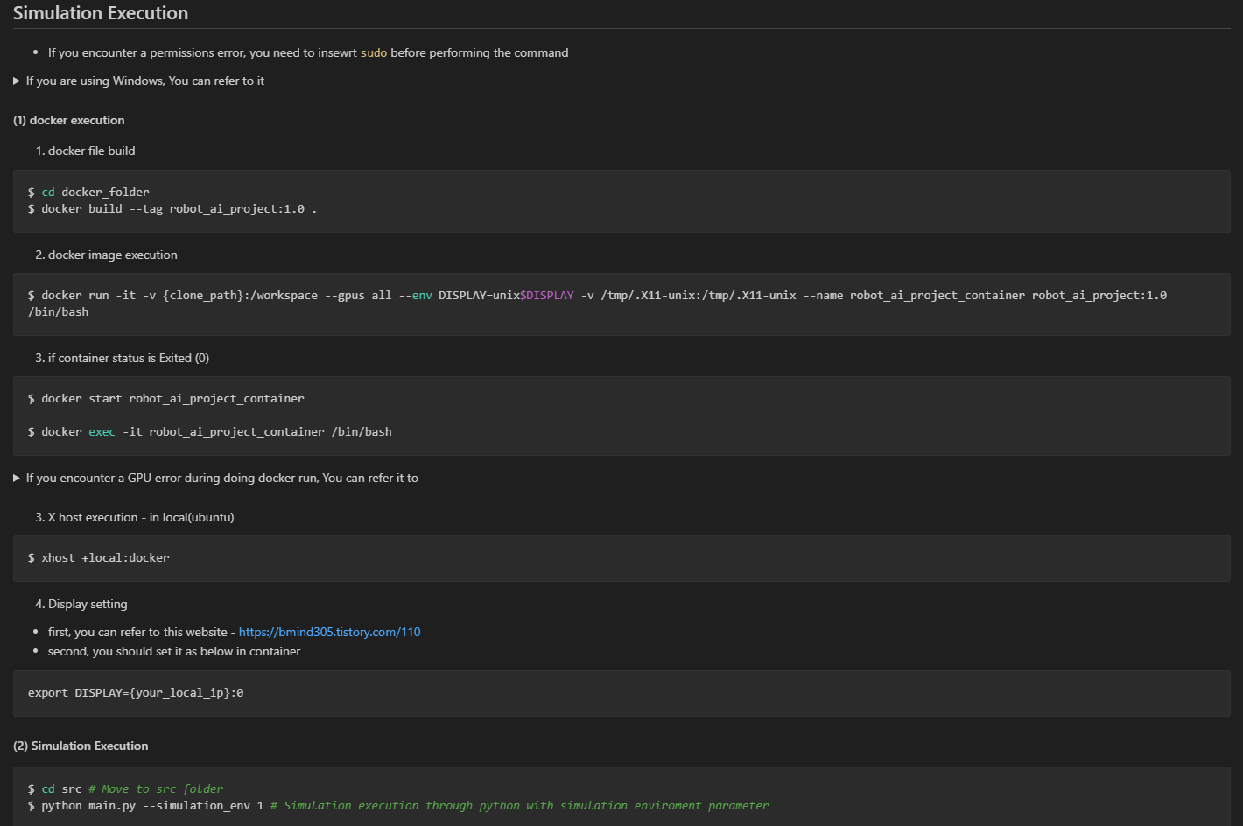
Demo
Notes:
- We wrote the procedure for running the demo in detail in the README file.
- If you want to run this demonstration, you can do it in order
- You can run both Windows and Ubuntu environments, but I recommend Ubuntu environments because Windows environments are more difficult.

Slide 13
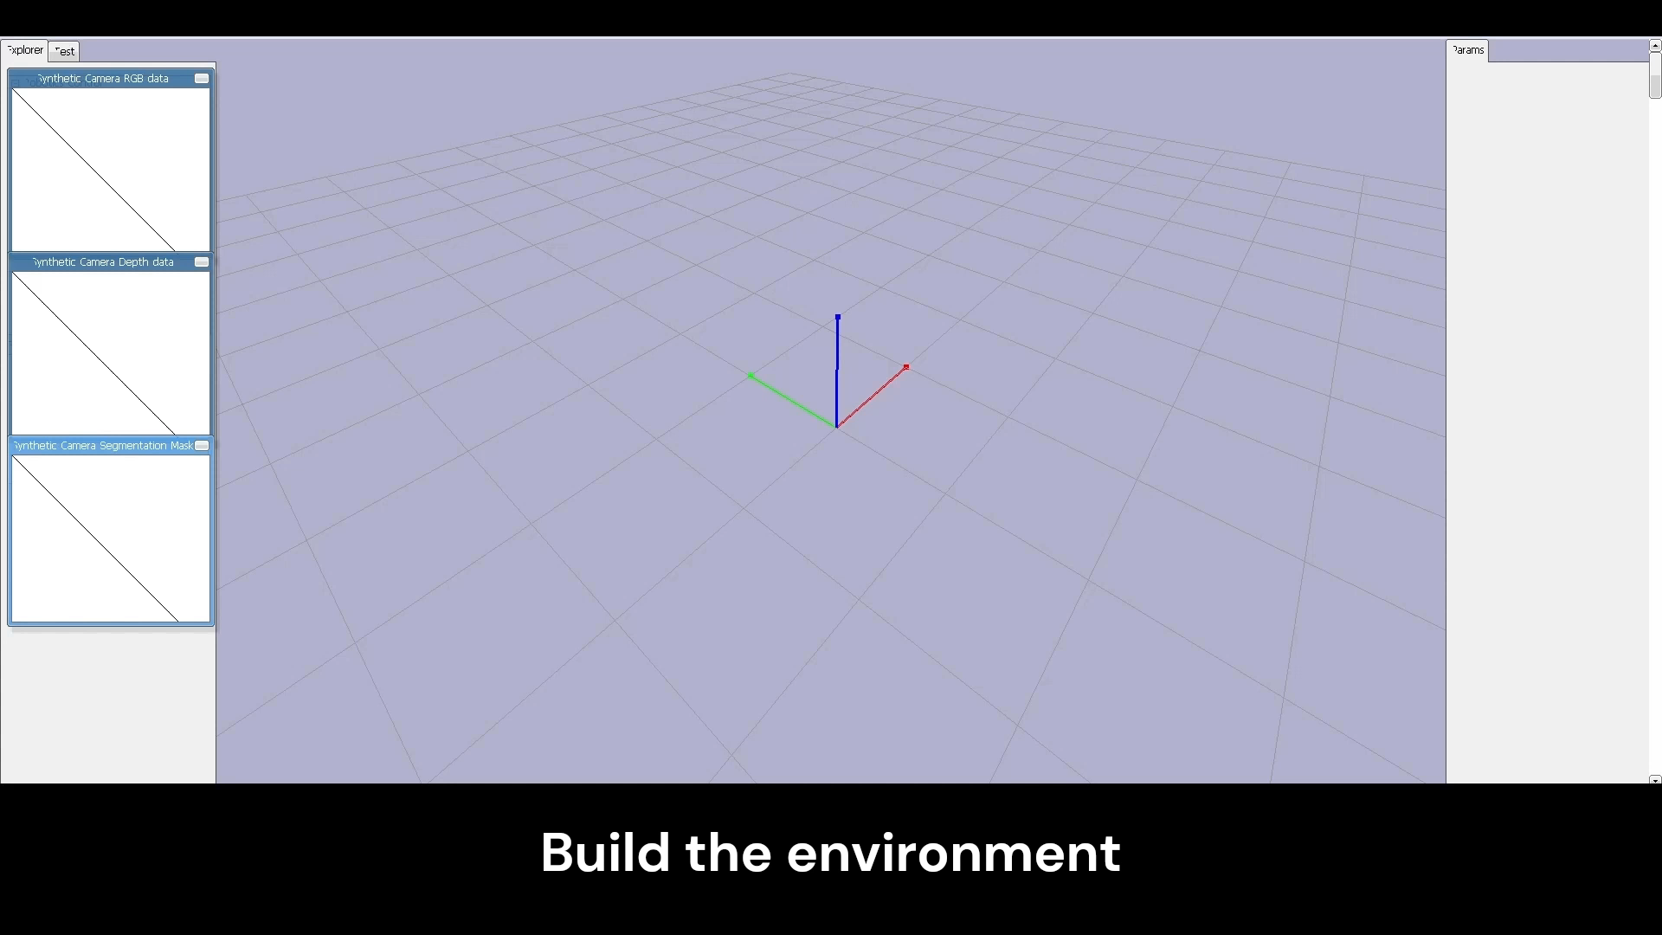
Demo
Command
- Instruction
- Goal point
- Style
: “pour the sauce”
: “right_hand”
: “shaking”
X 2
python main.py --instruction=“I want to eat fruit" --goal_point=“right_hand" --style=“circular"
Notes:
- If you've run the Docker container successfully, you can simply run the demo.
- Simply enter the above command
- This is first demo
- we entered “pour the sauce” and goal point is right hand, and style is circular
- First build the environment in Pybullet
- finds objects based on commands using CLIP
- and then pick up the object using GR-CNN Network
- and then detect skeleton of the human body
- and then Move to the target point using the motion of the given style.

Slide 14

Demo
Command
- Instruction
- Goal point
- Style
: “I want to eat fruit”
: “right_hand”
: “circular”
X 2
python main.py --instruction=“I want to eat fruit" --goal_point=“right_hand" --style=“circular"
Notes:
- This is second demo
- We are given a different command
- Instruction is “I want to eat fruit” goal point is right_hand, style is circular
- so robot pick up the banana
- also detect skeleton of the human body
- and then robot moves in a circle

Slide 15
Thank you.
Notes:
My presentation done
Thank you
Do you have any question?

